Slide 1
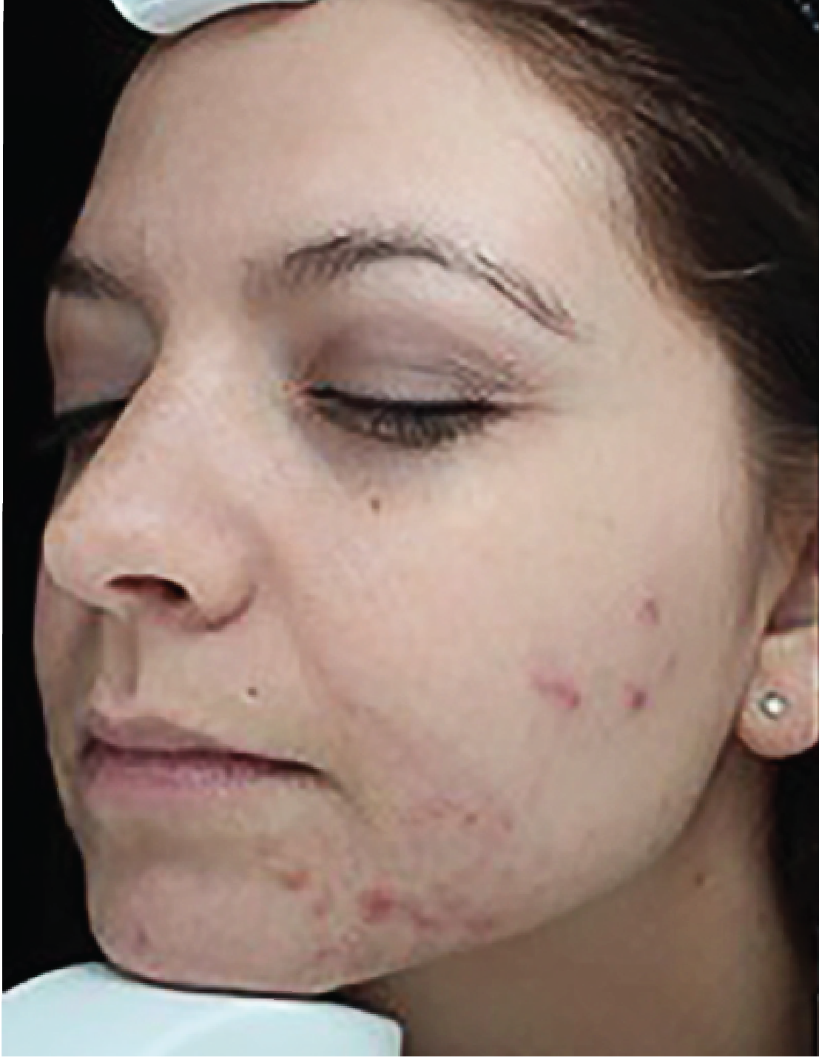
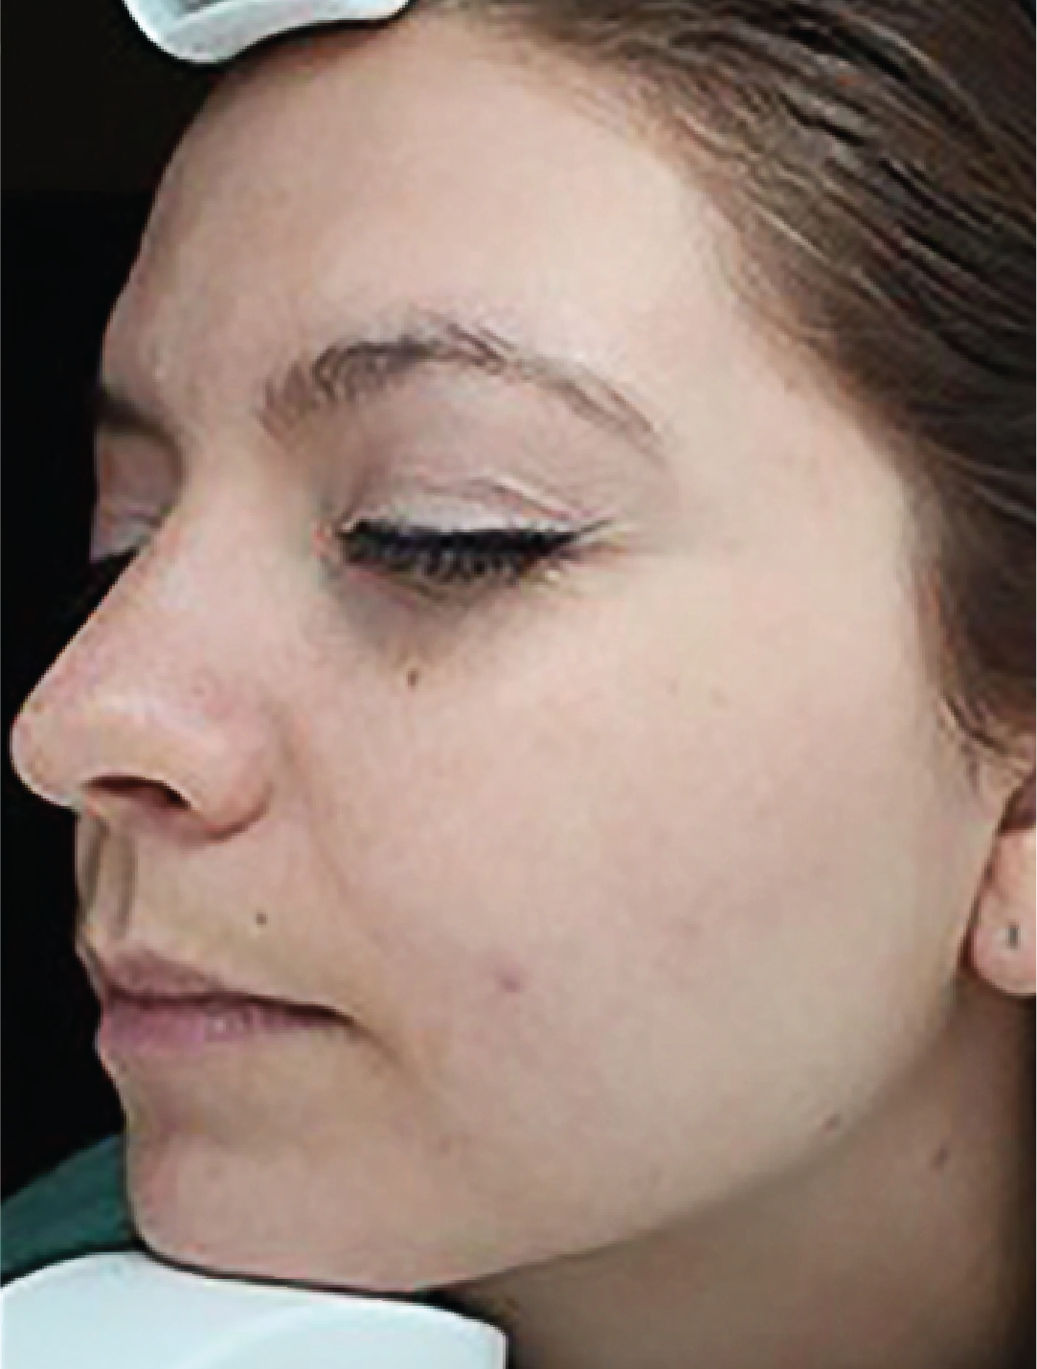
BEFORE / AFTER | 2 months post 3 tx | courtesy of Stephen P. Beals, MD
Forever Clear BBL™
420 nm filter, 5-6 J/cm², 160 ms, 15 ˚C Cooling, 3 Passes
590 nm filter, 15 J/cm², 30 ms, 10 ˚C Cooling, 1 Pass | Spot Treatment
©2018 Sciton, Inc. All rights reserved. 2600-039-70 Rev. A B&A FCBBL

